Slide 1
RNNs Based Time Series Forecasting
Apr. 12
Renjie Qian

Slide 2
Paper List
Sirignano, J., Cont, R. (2018), Universal Features of Price Formation in Financial Markets: Perspective from Deep Learning, arXiv: 1803.06917v1.
Ghaderi, A., Sanandaji, B. M., Ghaderi, F. (2017), Deep Forecast: Deep Learning-based Spatio-Temporal Forecasting, in ICML 2017 Time Series Workshop, Sydney, Australia.

Slide 3
Content
Temporal Forecasting: Based on One’s Own History
Spatio-Temporal Forecasting: Considering Interactive Effects

Slide 4
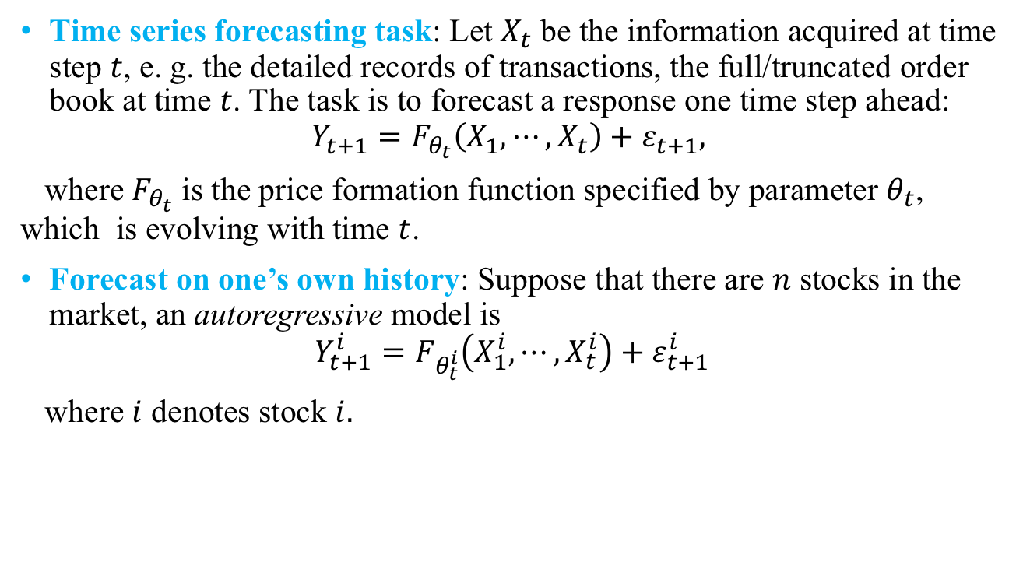
PART1 Temporal Forecasting: Based on One’s Own History
Time series forecasting task: Let $X_{t}$ be the information acquired at time step $t$, e. g. the detailed records of transactions, the full/truncated order book at time $t$. The task is to forecast a response one time step ahead:
$$Y_{t+1}=F_{θ_{t}}\left(X_{1}, ⋯, X_{t}\right)+ε_{t+1},$$
where $F_{θ_{t}}$ is the price formation function specified by parameter $θ_{t}$, which is evolving with time $t$.
Forecast on one’s own history: Suppose that there are $n$ stocks in the market, an autoregressive model is
$$Y_{t+1}^{i}=F_{θ_{t}^{i}}\left(X_{1}^{i}, ⋯, X_{t}^{i}\right)+ε_{t+1}^{i}$$
where $i$ denotes stock $i.$

Slide 5
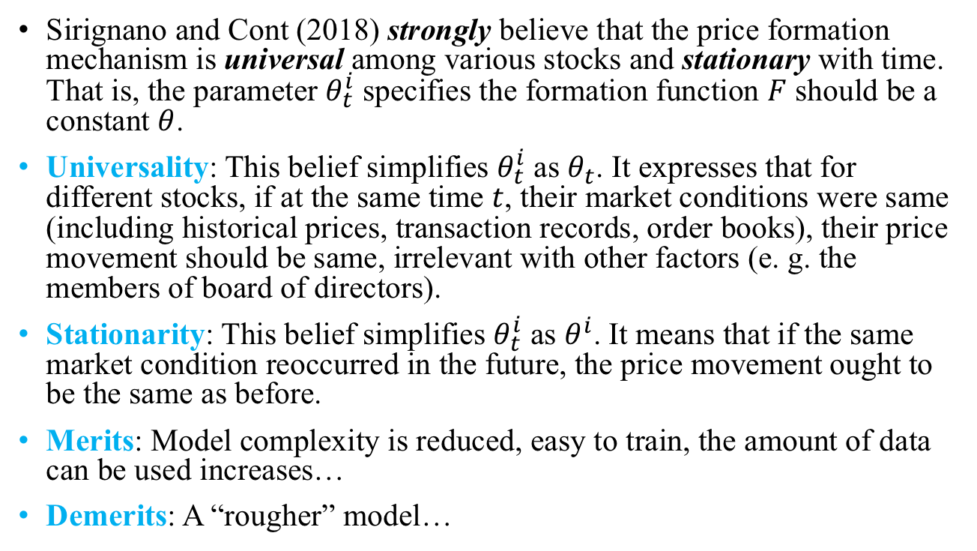
Assumption to Simplify the Model
Sirignano and Cont (2018) strongly believe that the price formation mechanism is universal among various stocks and stationary with time. That is, the parameter $θ_{t}^{i}$ specifies the formation function $F$ should be a constant $θ$.
Universality: This belief simplifies $θ_{t}^{i}$ as $θ_{t}$. It expresses that for different stocks, if at the same time $t$, their market conditions were same (including historical prices, transaction records, order books), their price movement should be same, irrelevant with other factors (e. g. the members of board of directors).
Stationarity: This belief simplifies $θ_{t}^{i}$ as $θ^{i}$. It means that if the same market condition reoccurred in the future, the price movement ought to be the same as before.
Merits: Model complexity is reduced, easy to train, the amount of data can be used increases…
Demerits: A “rougher” model…

Slide 6
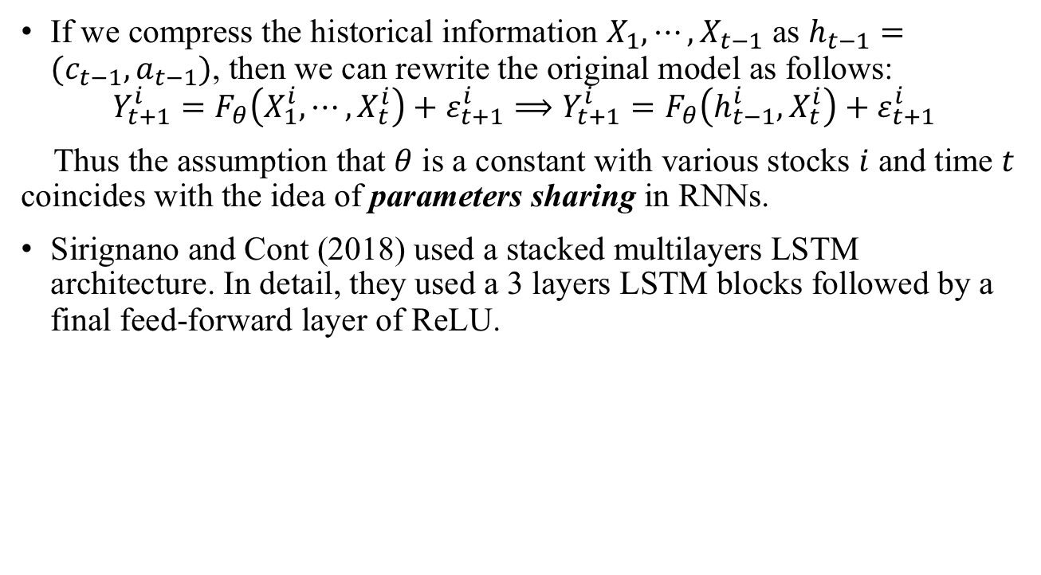
Architecture: Multilayers LSTM
If we compress the historical information $X_{1}, ⋯, X_{t−1}$ as $h_{t−1}=(c_{t−1}, a_{t−1})$, then we can rewrite the original model as follows:
$$Y_{t+1}^{i}=F_{θ}\left(X_{1}^{i}, ⋯, X_{t}^{i}\right)+ε_{t+1}^{i}⟹Y_{t+1}^{i}=F_{θ}\left(h_{t−1}^{i}, X_{t}^{i}\right)+ε_{t+1}^{i}$$
Thus the assumption that $θ$ is a constant with various stocks $i$ and time $t$ coincides with the idea of parameters sharing in RNNs.
Sirignano and Cont (2018) used a stacked multilayers LSTM architecture. In detail, they used a 3 layers LSTM blocks followed by a final feed-forward layer of ReLU.

Slide 7
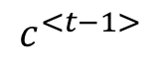
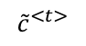
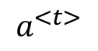
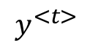
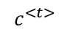
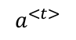
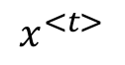
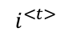
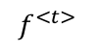
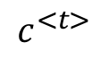
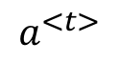
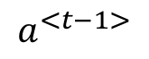
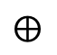
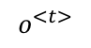
Recall the LSTM block…
$$y^{<t>}$$
softmax
$$a^{<t>}$$
-
-
$$c^{<t−1>}$$
$$c^{<t>}$$
-
*
$$⨁$$
-
$$c^{<t>}$$
*
tanh
$$a^{<t−1>}$$
*
$$a^{<t>}$$
$$f^{<t>}$$
$$i^{<t>}$$
$${\tilde{c}}^{<t>}$$
$$o^{<t>}$$
$$a^{<t>}$$
forget gate
update gate
tanh
output gate
$$x^{<t>}$$
LSTM block (Andrew Ng, 2018)

Slide 8
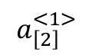
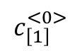
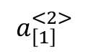
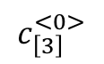
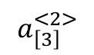
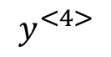
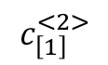
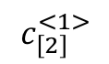
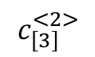
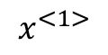
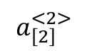
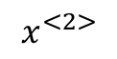
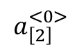
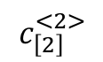
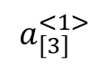
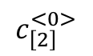
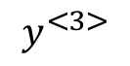
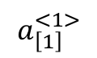
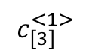
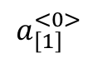
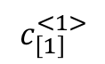
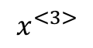
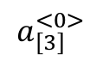
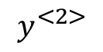
3 layers LSTM
$$y^{<2>}$$
-
$$y^{<3>}$$
-
$$y^{<4>}$$
-
softmax
softmax
softmax
relu
relu
relu
-
-
-
$$c_{\left[3\right]}^{<0>}$$
LSTM
$$c_{\left[3\right]}^{<1>}$$
LSTM
$$c_{\left[3\right]}^{<2>}$$
LSTM
$$a_{\left[3\right]}^{<0>}$$
$$a_{\left[3\right]}^{<1>}$$
$$a_{\left[3\right]}^{<2>}$$
-
-
-
$$c_{\left[2\right]}^{<0>}$$
LSTM
$$c_{\left[2\right]}^{<1>}$$
LSTM
$$c_{\left[2\right]}^{<2>}$$
LSTM
$$a_{\left[2\right]}^{<0>}$$
$$a_{\left[2\right]}^{<1>}$$
$$a_{\left[2\right]}^{<2>}$$
$$c_{\left[1\right]}^{<0>}$$
LSTM
$$c_{\left[1\right]}^{<1>}$$
LSTM
$$c_{\left[1\right]}^{<2>}$$
LSTM
$$a_{\left[1\right]}^{<0>}$$
$$a_{\left[1\right]}^{<1>}$$
$$a_{\left[1\right]}^{<2>}$$
$$x^{<1>}$$
$$x^{<2>}$$
$$x^{<3>}$$

Slide 9
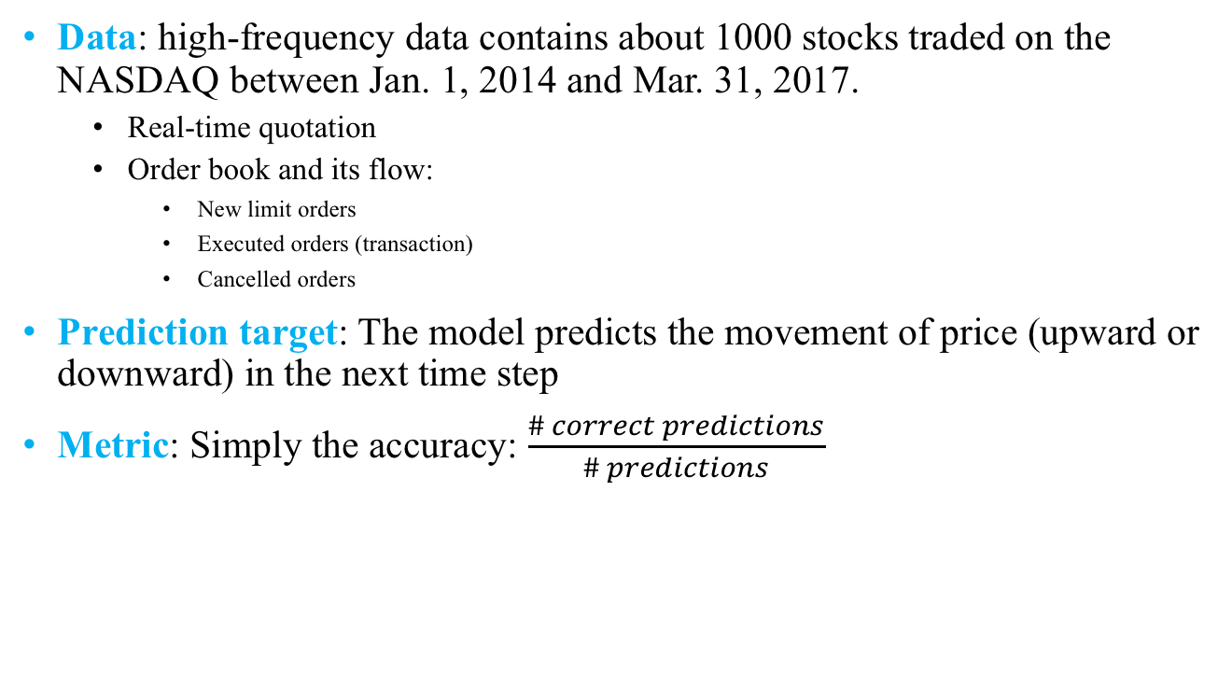
Technical Details
Data: high-frequency data contains about 1000 stocks traded on the NASDAQ between Jan. 1, 2014 and Mar. 31, 2017.
Real-time quotation
Order book and its flow:
New limit orders
Executed orders (transaction)
Cancelled orders
Prediction target: The model predicts the movement of price (upward or downward) in the next time step
Metric: Simply the accuracy: $\frac{\# correct predictions}{\# predictions}$

Slide 10
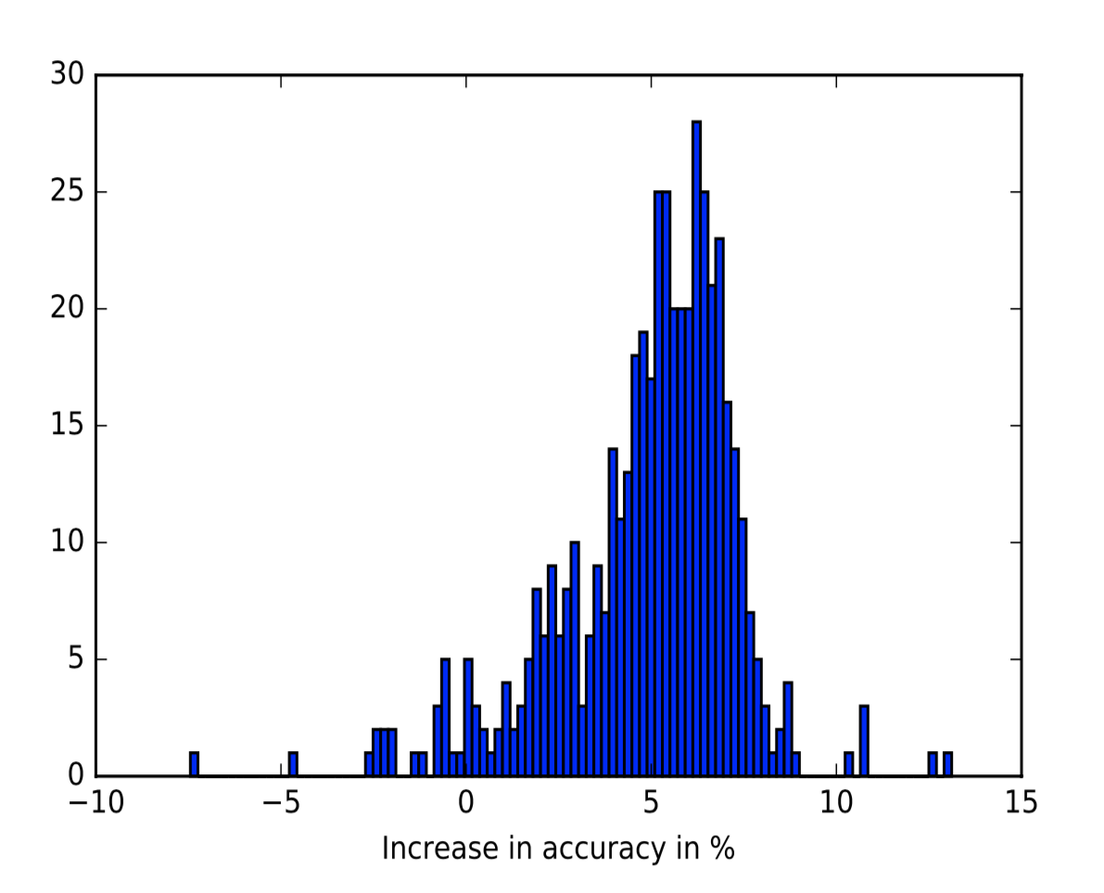
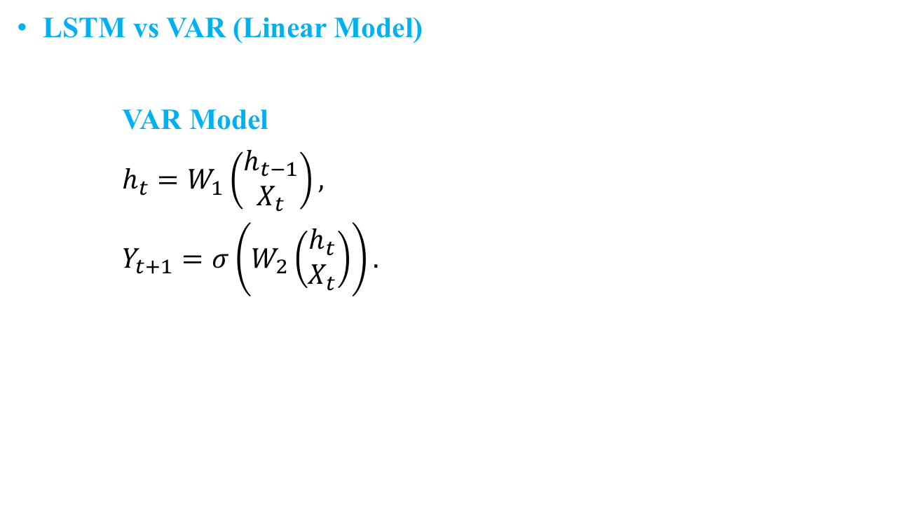
Experiments
LSTM vs VAR (Linear Model)
VAR Model
$h_{t}=W_{1}\left(\begin{matrix}h_{t−1} \\ X_{t}\end{matrix}\right),$
$Y_{t+1}=σ\left(W_{2}\left(\begin{matrix}h_{t} \\ X_{t}\end{matrix}\right)\right).$
Accuracy increase of stock-specific LSTM compared to stock-specific VAR

Slide 11
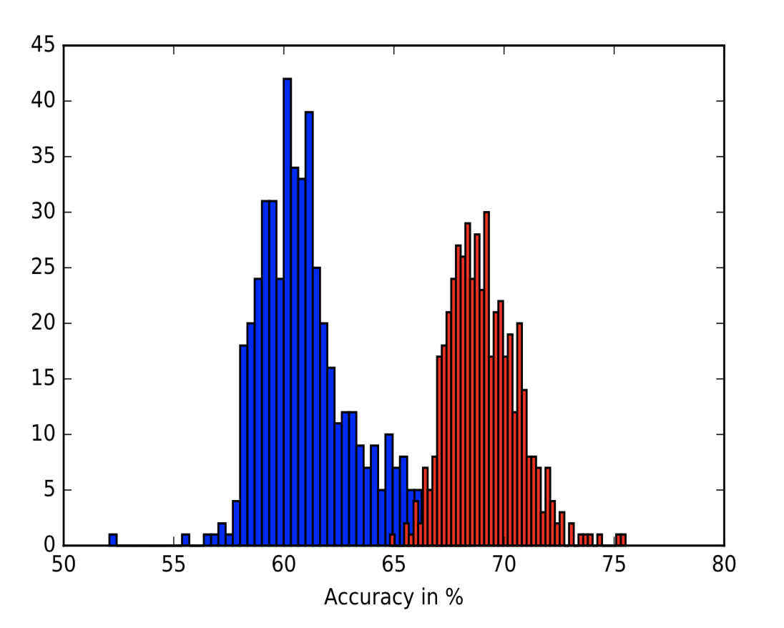
Universal LSTM (red) vs Stock-specific VAR (blue)

Slide 12
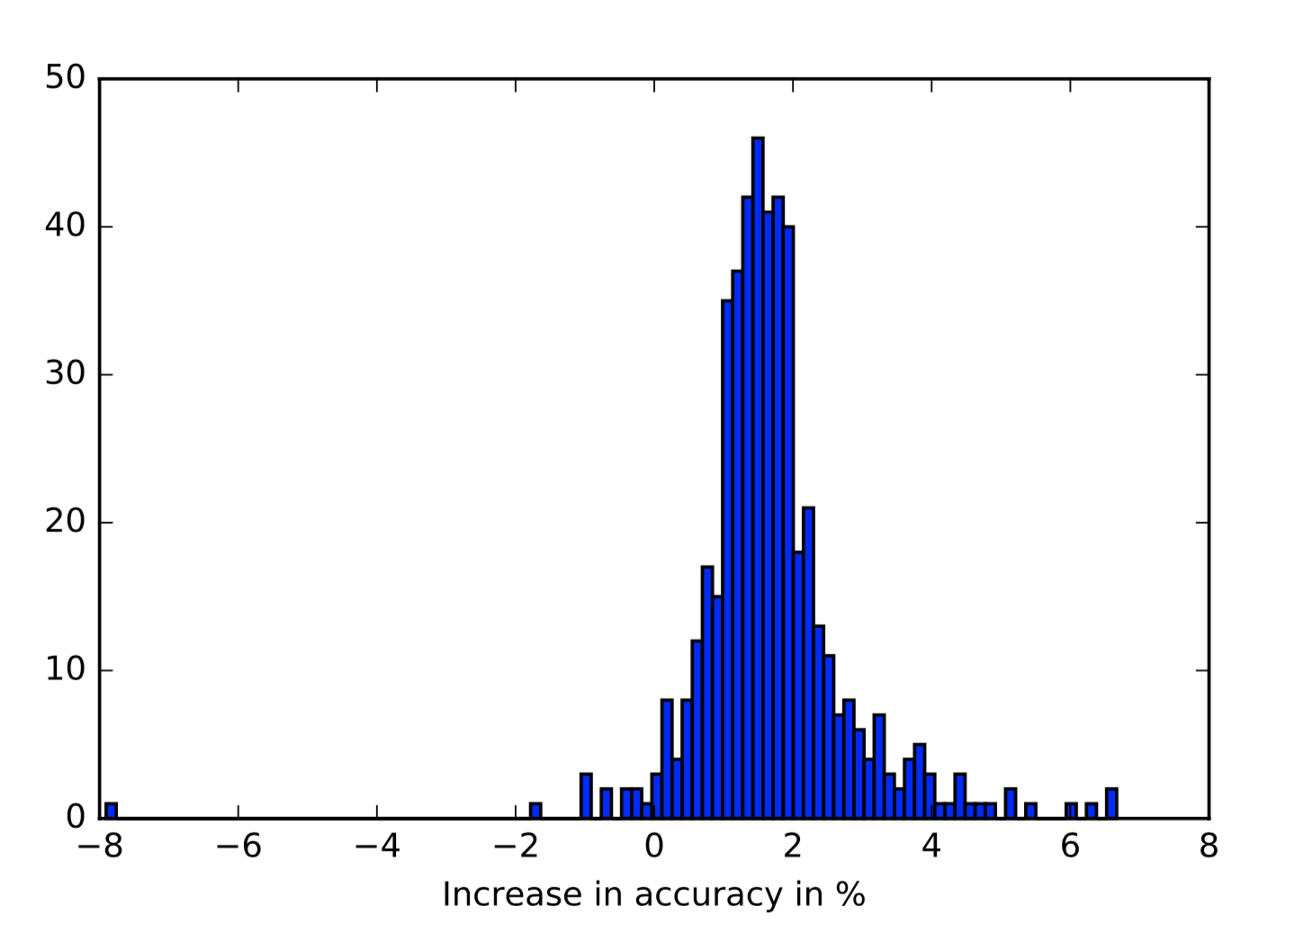
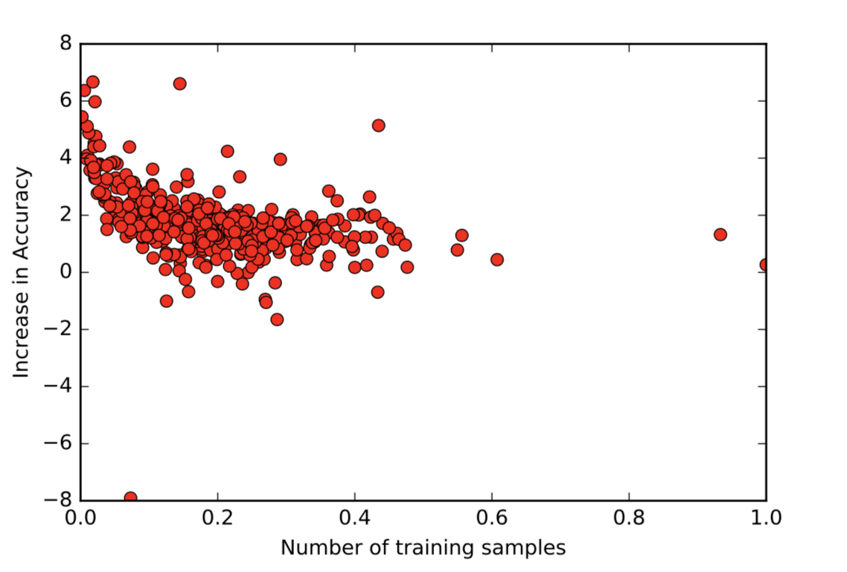
Universal Model vs Stock-specific Model:
Out-of-sample forecasting accuracy of the universal model compared with stock-specific models. Both are deep neural networks with 3 LSTM layers followed by a ReLU layer. All layers have 50 units. Models are trained to predict the direction of the next move. Comparison across 489 stocks, June-August, 2015.
Increase in out-of-sample forecast accuracy (in %) of the universal model compared to stock-specific model, as a function of size of training set for stock specific model (normalized by total sample size, N= 24.1 million). Models are trained to predict the direction of next price move. Comparison across 500 stocks, June-August, 2015.
Note: Sirignano and Cont (2018) also observed that partitioning the stocks into sectors or categories do not improve accuracy.

Slide 13
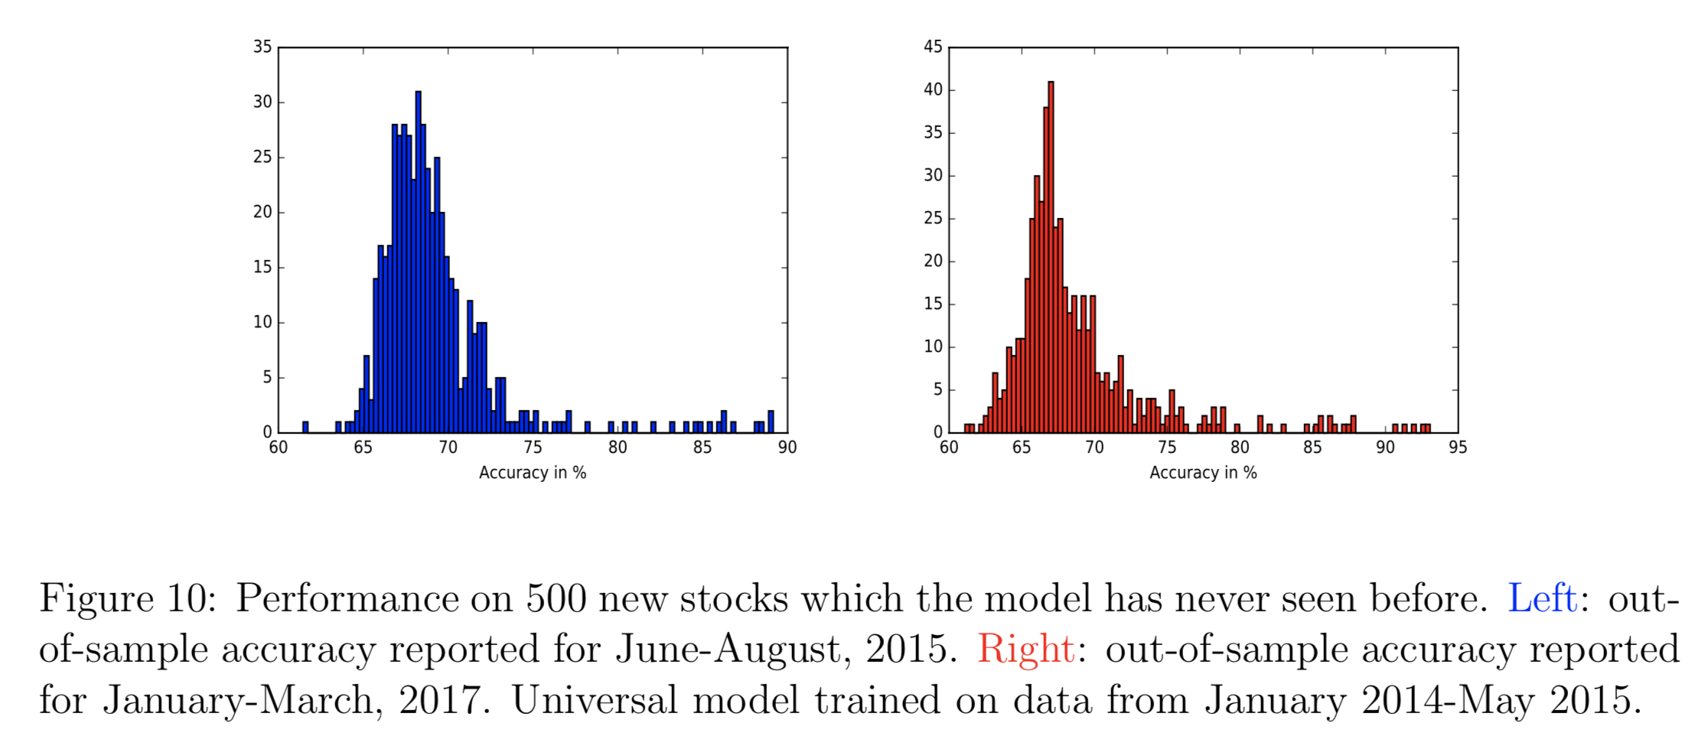
Stationarity of Mechanism

Slide 14
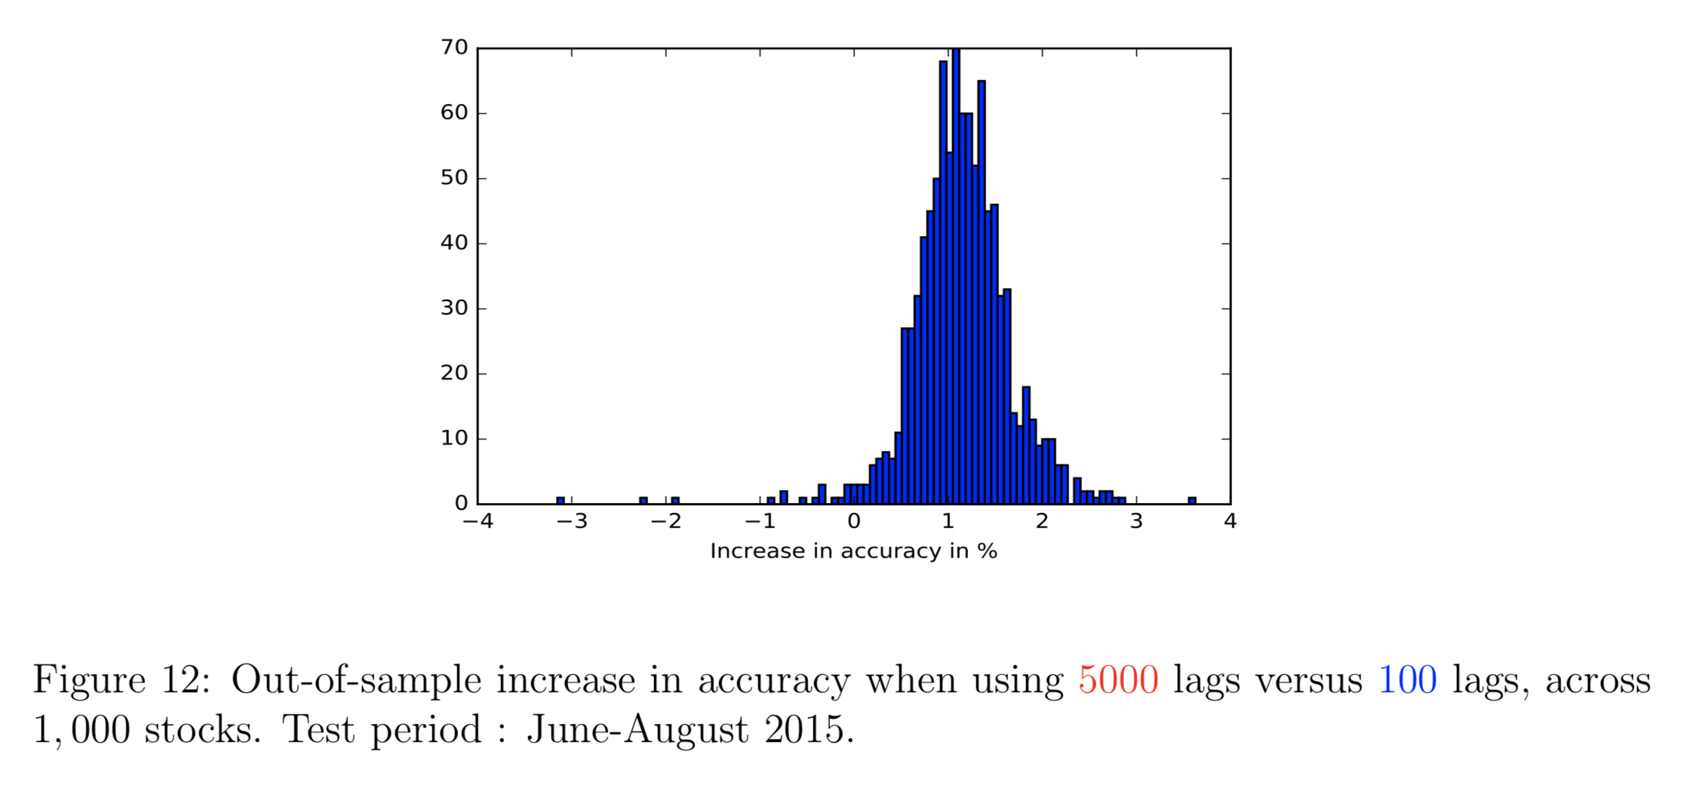
Long-range Dependency
[Remark] One lag is 1.7 seconds on average as noted in Sirignano, J., Cont, R. (2018).

Slide 15
Summary
😊 Universal and stationary multilayers LSTM model
😊 High-frequency data containing order book (as much information as possible)
😊 Long-range input instead of a short-time window input
😭 Only consider temporal dependency

Slide 16
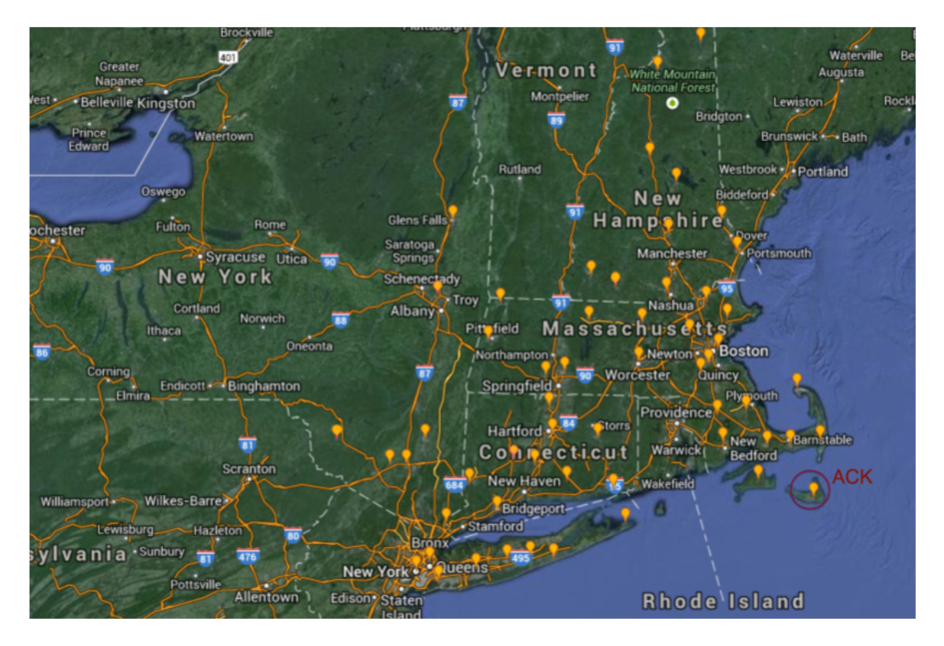

PART 2 Spatio-Temporal Forecasting: Considering Interactive Effects
Still we have $n$ time series $X_{1}^{i}, X_{2}^{i}, ⋯, X_{t}^{i}$, how to dig out the interrelationship among these series to help to forecast?
Ghaderi et. al (2017) add a simple layer to find out these relations.
The problem behind these is to forecast the wind speed in the northeast of United States to help wind power stations to work better.

Slide 17


Model Architecture for Forecasting One Time Step
Use LSTM with multi-timestep input but one-timestep output
Only input past $l$ timestep data (maybe historical data too long ago rarely affects wind speed in next timestep)
The LSTM unit estimates the spatio-interactive effects

Slide 18











Output (forecasting)
57-dim
$$⋯$$
-
-
-
$$⋯$$
57²-dim
$$⋯$$
$$c$$
LSTM
$$⋯$$
LSTM
$$c^{<t−1>}$$
LSTM
$$a$$
$$⋯$$
$$a^{<t−1>}$$
$$x^{<t−l>}$$
$$x^{<t−1>}$$
$$x^{<t>}$$
57-dim
57-dim
57-dim

Slide 19
Technical Details
Data: It is stored in DataFrame format. The data is collected per hour. It contains 57 columns (stations). Each record represent the wind speed measured in meter per second (m/s).
Prediction target: The model predicts wind speeds at all 57 stations in the next hour.
Training:
MSRProp optimizer
Learning rate = 0.001
Size of minibach = 3

Slide 20


Experiments
The following figure shows forecasting performance on Station No.1~16. Blue lines are real values and red ones are forecast values. Horizontal axis shows time steps and vertical axis shows wind speed(m/s).
Time window length $l$ = 12

Slide 21

Station No. 1

Slide 22


Time window length $l$ = 24

Slide 23

Station No. 1

Slide 24



Slide 25
Summary
😊 Digging out the relationships among various series helps to forecast them more accurately.
😭 The layer to dig out such relationships seems simple (even naïve), how about to replace it with a more complex structure estimating relationship graph?
In the wind speed forecasting problem, it seems that it’s enough to consider the past 12 time steps. In the stock price prediction problem, the number of time steps to be considered should be much longer.

